Slide 1
BHARTI INFOTECH AND SERVICES
Bilaspur , Chhattisgarh
Introduction to DPDT switch

Slide 2
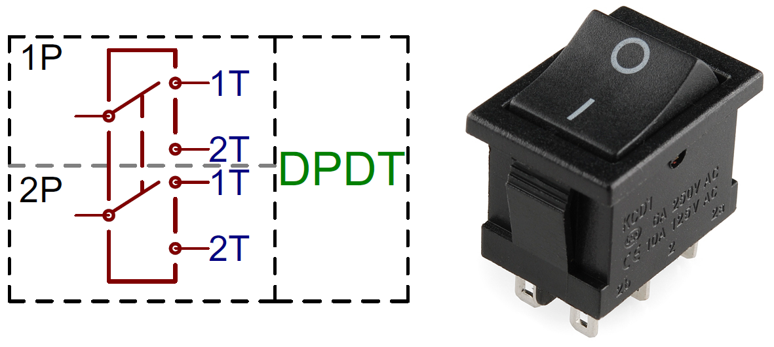
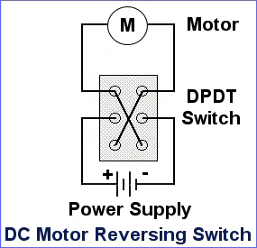

Slide 3
What is DPDT switch ?
Adding another pole to the SPDT creates a double-pole, double-throw (DPDT)switch. Basically two SPDT switches, which can control two separate circuits, but are always switched together by a single actuator. DPDTs should have six terminals. A DPDT circuit symbol, and a 6-terminal DPDT rocker switch.
double pole double throw
SPST stands for single pole single throw and DPDT stands for double pole double throw. A SPST switch is a simple on/off type switch and can be used for coil splitting and as a kill switch for the guitar. DPDT switches typically have a total of 6 terminals.

Slide 4
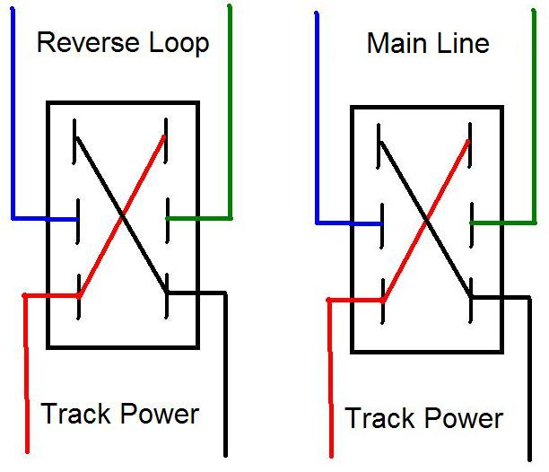
Analog Operations In the early days of Direct Current model railroading, reverse loops had to be controlled by hand, and the DPDT was perfect for the job. The DPDT was wired in such a way that power was fed into the switch from the transformer and then the track polarity could be changed by throwing the DPDT. While the train was moving through the reverse loop, the track polarity of the main line was changed with a secondDPDT:
The reverse switch inside the DC train transformer was also a DPDT, wired in the same fashion but could not be used since the train was in motion. So, the main line and the reverse loop had to be controlled in this manner.

Slide 5
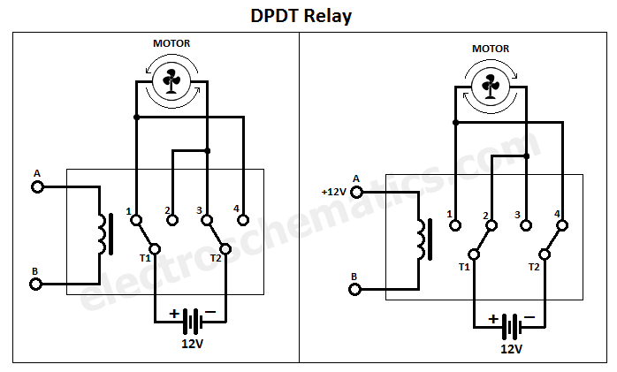
DPDT switches typically have a total of 6 terminals. There are two isolated common terminals, usually located side by side in the center of the switch. Each of the common terminals can be switched between making contact with one of two other terminals, usually located in two rows on either end of the switch.
The DPDT relay (Double Pole Double Throw) is quite interesting and can be used in various scenarious, including for changing the direction of a motor as you can see in the picture below. It has 2 terminals and 4 connectors and you can look at the DPDT relay as the equivalent of 2 Single Pole Double Throw SPDT relays.

Slide 6
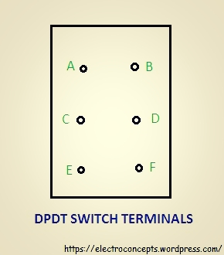
As you can see in the schematic the 12V battery (or use other voltages) is connected with the plus at terminal T1 and minus at terminal T2. The contact 1 and 4 are connected together as 2 and 3 are too.
Without voltage applied to the coil the battery plus is connected to contact 1 (and 4) and minus to 3 (and 2) therefore the motor is turning in one direction (let’s say clockwise). When voltage is applied to the coil then the relay switches and now T1 (plus) is connected to contact 2 (and 3) and T2 (minus) is connected to 4 (and 1) therefore the motor is changing the direction of rotation.
TO CONTROL DC MOTOR USING DPDT SWITCH
A dc motor has 2 terminals and a dpdt switch has 6 terminals.
Let us name them A,B,C,D,E,F .

Slide 7
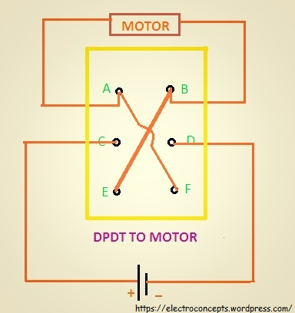
step 1: Connect a wire between ‘A’ and ‘F’ terminals.
step 2: Connect a wire between ‘B’ and ‘E’ terminals. (you can permanently solder the wire as shown in fig below)
step 3: Connect the dc motor between terminals ‘A’ and ‘B’
step 4: Connect a battery source between terminals ‘C’ and ‘D’

